Slide 1
Image Classification using CNN

Slide 2
Image Classification Overview
Goal: Assign an image x to one of K classes.
Example: Cat vs Dog vs Car, etc.
Output: Class probabilities p(y∣x).

Slide 3
Traditional Methods (Before CNNs)
Handcrafted features:
SIFT, HOG, color histograms.
Separate classifier:
SVM, Random Forest, etc.
Limitations:
Feature extraction was manual.
Not end-to-end trainable.

Slide 4
Structure of a CNN
Basic layers:
Convolutional Layer: feature extraction (local patterns).
Activation Function: introduces non-linearity (e.g., ReLU).
Pooling Layer: downsampling (reduce size and computation).
Fully Connected Layer: classification (final prediction).
[Input → Conv → ReLU → Pool → FC → Output]

Slide 5
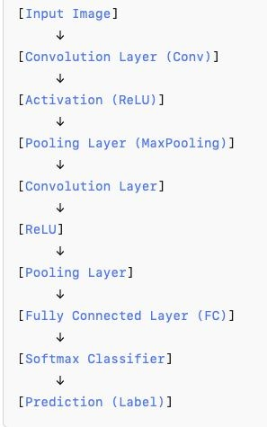
Basic CNN Architecture
Fig. Basic CNN architecture

Slide 6
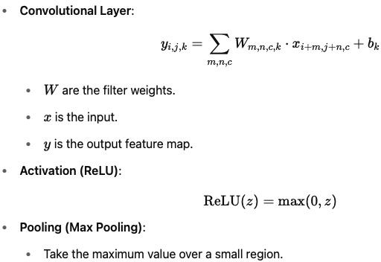
Mathematically, What Happens?

Slide 7
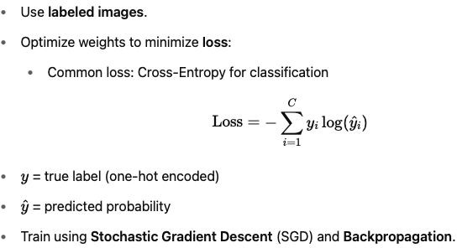
Training a CNN

Slide 8
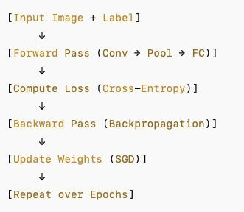
CNN Training Loop
Fig. CNN training loop

Slide 9
Challenges in Deep CNNs
As networks get deeper:
Vanishing gradients: early layers stop learning.
Overfitting: too complex, fits noise.
Optimization difficulties: stuck during training.
Deeper ≠ Always better!

Slide 10
Transition: Motivation for Residual Networks
Can we build very deep CNNs without these problems?
Enter: ResNet (Residual Networks)!

Slide 11
What is ResNet?
ResNet is a type of deep convolutional neural network (CNN).
It was introduced in 2015 by Kaiming He and his team.
It won the ImageNet competition in 2015 by a large margin

Slide 12
Why is ResNet special?
Normal deep networks suffer from degradation: after a certain depth, adding more layers actually makes
performance worse, not better.
ResNet solves this with skip connections (or residual connections).

Slide 13
Motivation
Deep networks improve image recognition.
But deeper networks are harder to train due to:
Vanishing/Exploding gradients
Degradation problem (accuracy saturates and degrades)

Slide 14
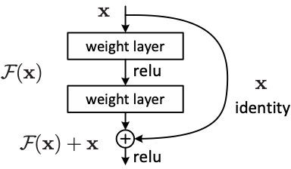
Residual Block Architecture
Shortcut connections:
Identity mapping without extra parameters.
Combine with stacked layers by element-wise addition.
Fig. Residual learning: a building block.

Slide 15
Why is ResNet special?
Instead of learning a direct mapping, it learns a residual mapping:
H(x)=F(x)+xH(x)=F(x)+x
where:
x = input
F(x) = something learned (residual)
H(x) = output
This makes it easier for the network to optimize - if learning nothing is better, it can just set
F(x)=0.

Slide 16
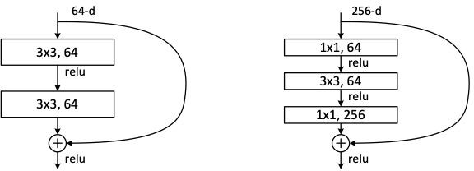
A deeper residual function
Fig. Left: a building block (on 56×56 feature maps).
Right: a “bottleneck” building block for ResNet-50/101/152.

Slide 17
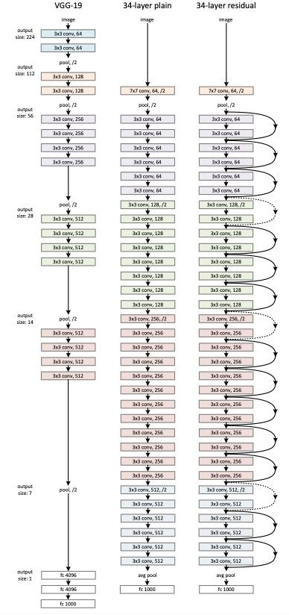
Example network architectures
Fig. Example network architecture
Left: the VGG-19 model (19.6 billion FLOPs) as a reference.
Middle: a plain network with 34 parameter layers (3.6 billion FLOPs). Right: a residual network with 34 parameter layers (3.6 billion FLOPs). The dotted shortcuts increase dimensions.
17

Slide 18
Highway Networks vs Residual Networks
What are Highway Networks?
Proposed earlier than ResNets (Srivastava et al., 2015).
Key idea: Use learnable gates to regulate information flow.
Formulation:
y=H(x,WH)⋅T(x,WT)+x⋅(1−T(x,WT))
where:
H(x,WH) = nonlinear transform
T(x,WT) = transform gate (values between 0 and 1)
T(x) is typically implemented using a sigmoid activation.

Slide 19
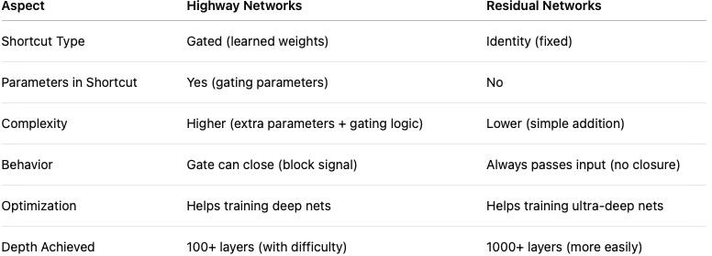
Key Differences
Table. Highway Networks vs Residual Networks

Slide 20
Highway vs ResNet - Mathematical View
Highway has two paths (transform and carry), and learns how much to transform.
Residual simply adds the input, forcing all layers to learn a small residual adjustment.

Slide 21
Highway Networks vs Residual Networks
Highway Networks were an important step toward deeper learning.
Residual Networks simplified the idea:
No gates.
Pure addition.
Much easier to optimize.
Became the standard for deep architectures!

Slide 22
Why Residual Networks Work
Residuals have smaller magnitude.
Layers modify signals slightly (stability).
Easier convergence and better optimization.

Slide 23
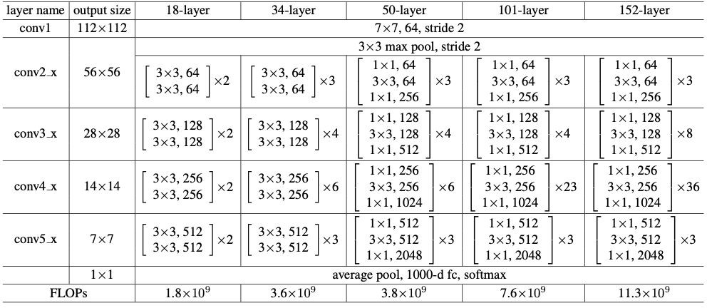
Architectures for different variants of ResNet
Table. Architectures for ImageNet. Building blocks are shown in brackets, with the numbers of blocks stacked.
Downsampling is performed by conv3 1, conv4 1, and conv5 1 with a stride of 2.
23

Slide 24
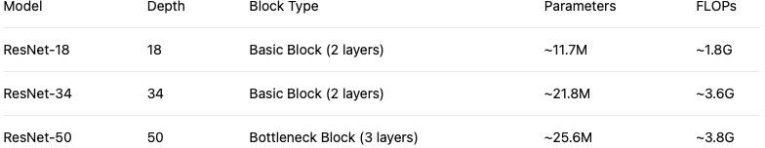
ResNet-18 vs ResNet-34 vs ResNet-50
Table. Comparison of ResNet 18 vs 34 vs 50

Slide 25
Limitations of ResNet
1. ● ● ● | Computational Cost Deeper networks require more memory and more compute. Even with bottlenecks, training 152+ layer ResNets is expensive. Hard to deploy on devices with limited resources (e.g., mobile).
2. | Optimization Becomes Hard at Very Large Depth
● | Although ResNets mitigate degradation, extremely deep ResNets (e.g., 1202 layers) still overfit on small
● | datasets like CIFAR-10. Longer training time, diminishing returns after certain depth.

Slide 26
Limitations of ResNet
Shortcut Connections May Bypass Too Much
In some cases, shortcuts dominate, and learning becomes less meaningful.
Later improvements (e.g., DenseNet) attempt to better utilize intermediate features.
Lack of Feature Reuse
ResNet reuses inputs by addition, but doesn’t explicitly encourage combining features across multiple layers.
Later models (DenseNet, EfficientNet) address this by feature concatenation.

Slide 27
Limitations of ResNet
Architectural Rigidity
All blocks are roughly the same structure (conv layers and addition).
Hard to directly incorporate attention mechanisms, multi-scale features without modifications.
No Dynamic Adaptation
Standard ResNet behaves the same for all inputs.
Later models (e.g., ResNeXt, EfficientNet) improve flexibility by using group convolutions and width scaling.

Slide 28
New Variants of ResNet
ResNeXt (2017)
Idea: Use grouped convolutions.
Block structure: Split, Transform, Merge.
Formula: Instead of increasing depth/width, increase cardinality (number of parallel paths).
Advantage: Better accuracy with similar complexity as ResNet.
Key Paper: Aggregated Residual Transformations for Deep Neural Networks (Xie et al.)
DenseNet (2017)
Idea: Each layer gets inputs from all previous layers via concatenation.
Difference from ResNet: Instead of adding features (residual), DenseNet concatenates features.
Advantage: Feature reuse, fewer parameters.
Key Paper: Densely Connected Convolutional Networks (Huang et al.)

Slide 29
New Variants of ResNet
ResNet v2 (2016)
Idea: Modify the original ResNet with:
Pre-activation ordering: BN → ReLU → Conv (instead of Conv → BN → ReLU).
Advantage: Better optimization, especially for deeper networks.
Key Paper: Identity Mappings in Deep Residual Networks (He et al.)
Wide ResNet (WRN) (2016)
Idea: Instead of making deeper networks, make wider networks (more channels per layer).
Observation: Wider ResNets are easier to optimize and generalize better.
Key Paper: Wide Residual Networks (Zagoruyko and Komodakis)

Slide 30
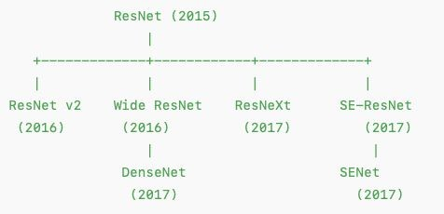
New Variants of ResNet
Attention-ResNet (e.g., SE-ResNet)
Idea: Add attention mechanisms inside ResNet blocks.
Example: Squeeze-and-Excitation (SE) modules adaptively recalibrate feature maps.
Advantage: Focus on more important features.
Key Paper: Squeeze-and-Excitation Networks (Hu et al.)
Fig. ResNet architecture hierarchical representation

Slide 31
Summary
ResNet (2015) is the root.
ResNet v2 → Pre-activation ordering.
Wide ResNet → Wider blocks instead of deeper.
ResNeXt → Parallel aggregated transforms (grouped convs).
SE-ResNet → Channel-wise attention inside blocks.
DenseNet → Concatenated features (inspired partially by ResNet’s success but not a strict direct descendant).

Slide 32
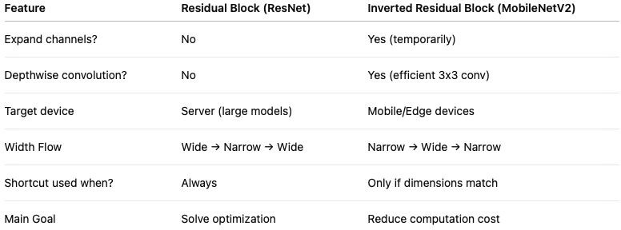
Additional topics
Table. Residual vs Inverted Residual Blocks

